Slide 1
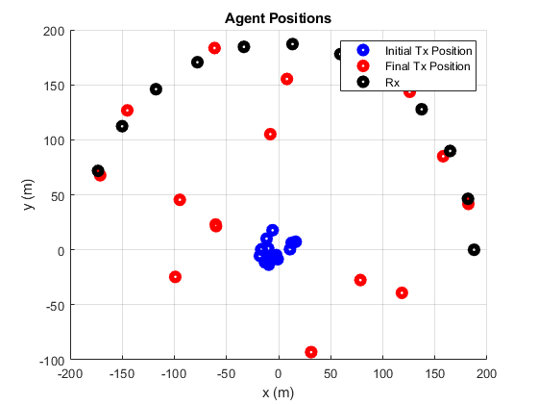
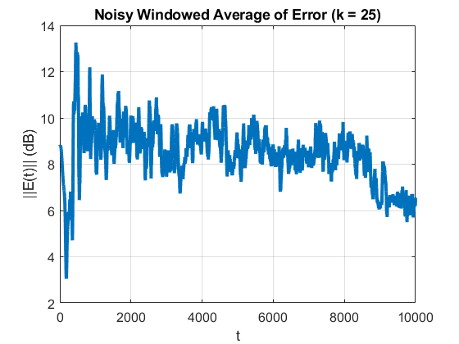
Agent Position Optimization Progress: No Penalty Version
Algorithm runs w/few divergences
Agents no longer leave the workspace
Very small weight (<< 1) applied to 2nd deriv term
Currently looking into different motion penalties

Slide 2
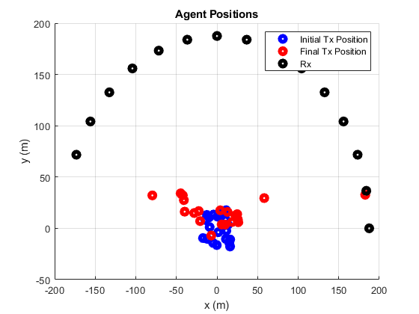
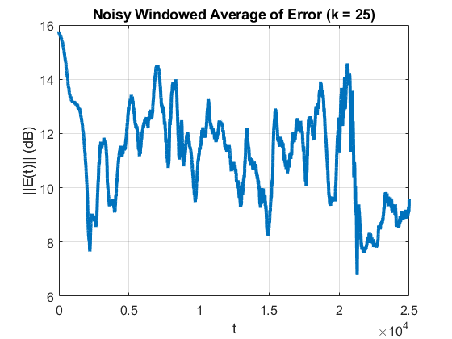
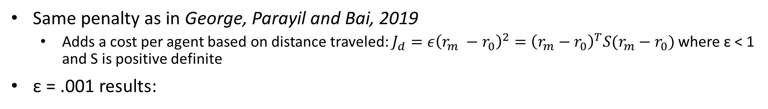
Agent Position Optimization Progress: Travel Distance Penalty
Same penalty as in George, Parayil and Bai, 2019
Adds a cost per agent based on distance traveled: $J_{d}=ε{\left(r_{m} −r_{0}\right)}^{2}={\left(r_{m}−r_{0}\right)}^{T}S(r_{m}−r_{0})$where ε < 1 and S is positive definite
ε = .001 results:

Slide 3
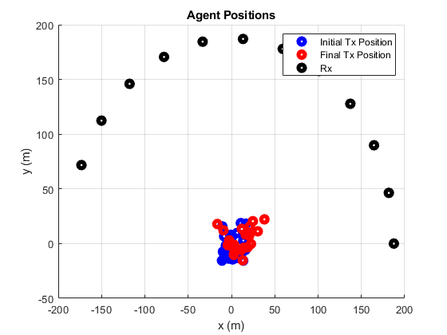
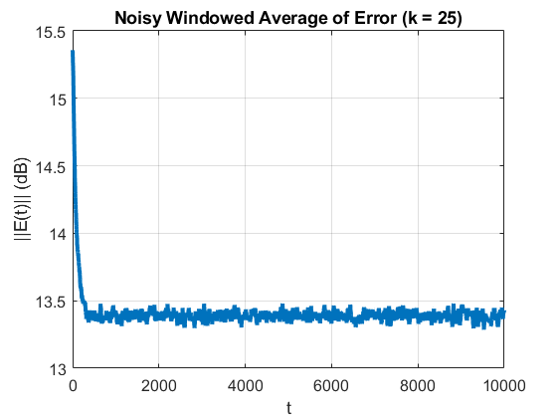
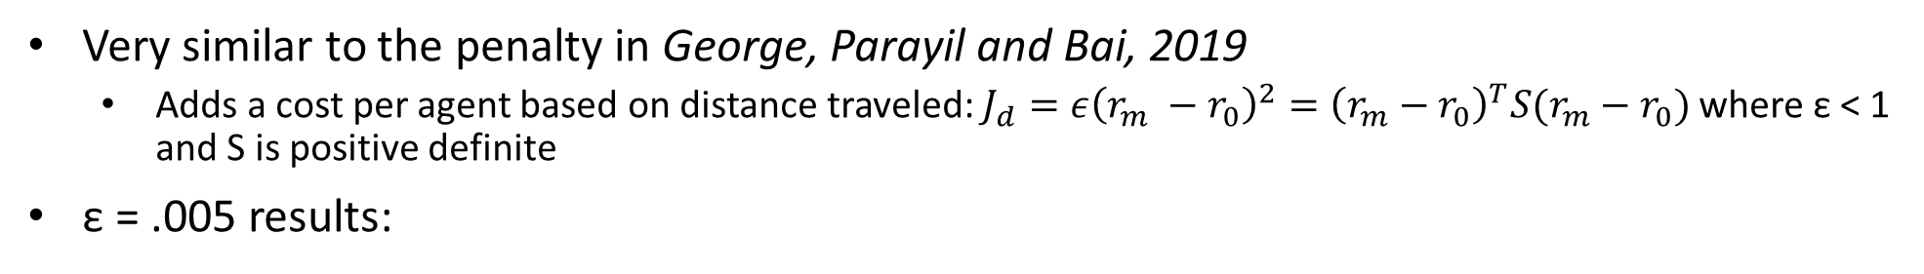
Agent Position Optimization Progress: Travel Distance Penalty
Very similar to the penalty in George, Parayil and Bai, 2019
Adds a cost per agent based on distance traveled: $J_{d}=ε{\left(r_{m} −r_{0}\right)}^{2}={\left(r_{m}−r_{0}\right)}^{T}S(r_{m}−r_{0})$where ε < 1 and S is positive definite
ε = .005 results:

Slide 4
Path Forward
Final touches on agent position optimization
Results from iterative optimization (phase/amplitude IPG → position IPG)
Starting to extend to moving Rx
First steps: single mobile Rx moving in a line

